Slide 1

Varendra University
Dept. of Computer Science & Engineering (CSE)
Lab 5
Course Title: Microprocessor and Assembly Language Lab
Course No: CSE 334
Prepared By:
Md. Adnan Sami
Lecturer, Dept. of CSE, VU

Slide 2
Experiment Date: April 8, 2025
Experiment No: 05
Name of the Experiment:
Write some code in assembly language for division of 2 number using EMU8086.
Write some code in assembly language for converting lowercase to uppercase using EMU8086.

Slide 3
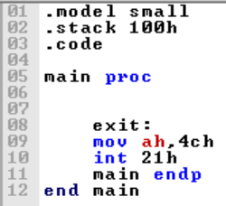
Return

Slide 4
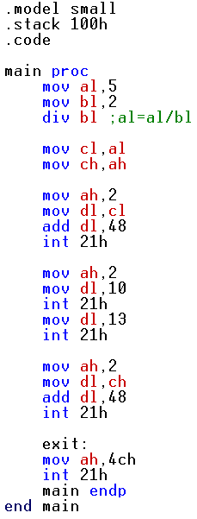
Write some code in assembly language for division of 2
number using EMU8086.

Slide 5
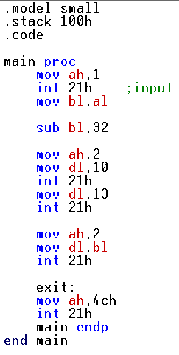
2. Write some code in assembly language for converting lowercase to uppercase using EMU8086.
Notes:
s

